Slide 1
INVESTMENT CASE STUDY SUBMISSION
Group Name:
Nitin Srivastava
Prasoon Dayal

Slide 2
Abstract
Business Objective:
Identify the best sectors, countries, and a suitable investment type for making investments.
Data Source:
Real investment data from crunchbase.com
Analyzed more than 66,000 companies listed with different countries, investment types and sectors.

Slide 3
Problem Solving
Identifying investment type
Highest average amount of investment
Identifying country
English speaking country
Identifying Sector
Highest number
of investments
Investment Type
Analysis of the most favourable investment type for Spark funds on the basis of average amount of investment type.
Output -> Favourable investment type
Country
Analysis of the countries for the Favourable investment type
Top 9 countries with this investment type
Output -> Top 3 English Speaking Countries with this type of investment
Sector
Analysis of the most favourable Sector.

Slide 4
Analysis – Investment type
Identify Average Investment for each funding type.
Identify Investment Type with average amount between 5 to 15 million USD.
Assumption: Companies for which raised amount data was missing were ignored.
Conclusion: Recommendation: “Venture” Investment Type

Slide 5
Analysis – Country
Identify countries for recommended investment type.
Identify total amount invested for each country with recommended investment type.
Identify Top 9 countries for recommended investment type with highest investment.
Identify Top 3 English speaking countries
Assumption: Companies with no country codes were ignored.
Reference for Country codes taken as per ISO Code 3 convention.
Conclusion: Recommended Countries - United States, Great Britain and India

Slide 6
Analysis - Sector
Identify number of investments for each sector for recommended countries and investment type.
Identify Top 3 sectors with highest number of investments for each recommended country and recommended investment type.
Assumption: Companies for which raised amount data was missing were ignored.
Conclusion:
GBR | IND | USA
Others | Others | Others
Cleantech / Semiconductors | News, Search and Messaging | Cleantech / Semiconductors
Social, Finance, Analytics, Advertising | Social, Finance, Analytics, Advertising | Social, Finance, Analytics, Advertising

Slide 7
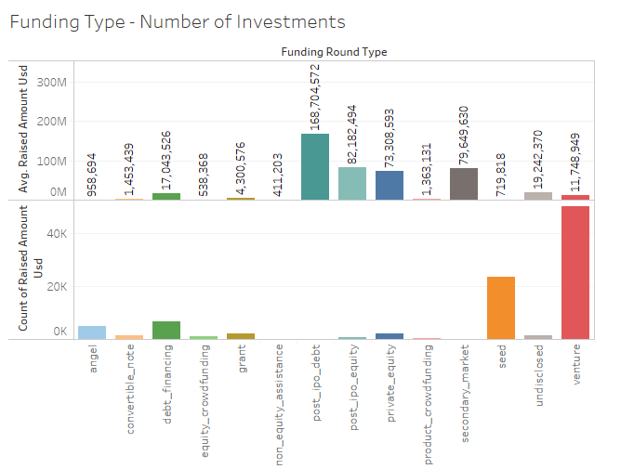
Investment Type
“Venture” Investment Type is the
recommended investment type.

Slide 8
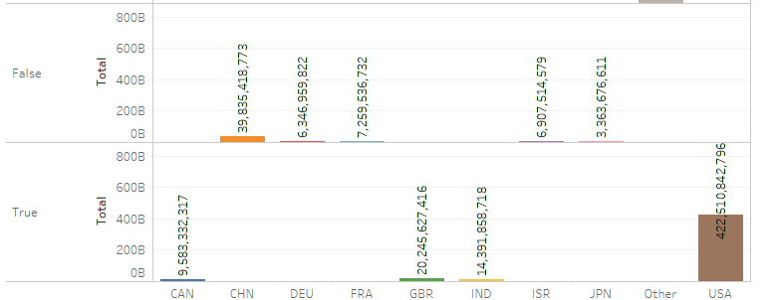
Country
USA, Great Britain and India are
recommended for “venture” investment type.

Slide 9
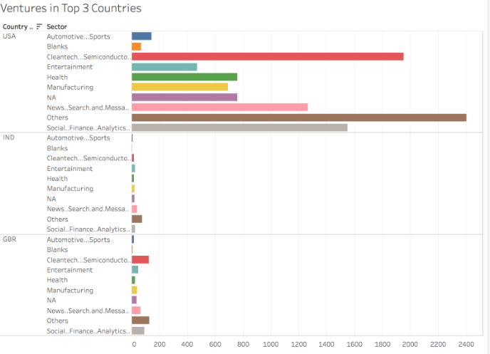
Sector
Sectors identified for each recommended
country

Slide 10
Conclusion
Recommendation: “Venture” Investment Type
Recommended Countries : United States, Great Britain and India
Recommended Sectors USA:
Others
Cleantech/Semiconductors
Social, Finance, Analytics, Advertising
Recommended Sectors INDIA:
Others
News, Search and Messaging
Social, Finance, Analytics, Advertising
Recommended Sectors Great Britain:
Others
Cleantech/Semiconductors
Social, Finance, Analytics, Advertising

